Slide 1
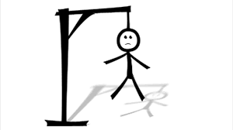
The Hangman Game

Slide 2
It’s a simple guess game. The player will be offered some specific number of guesses(according to the number of letters in the assigned word).
Player has to guess the word in those limited chances.
The game offers the number of letters in the word, the player has to guess, as a hint.
If the player guesses the right letter, the letter will be displayed on its correct position.
For each wrong guess, a body part will be displayed…hanging!
Dare save your Hangman?
About The Game:-

Slide 3
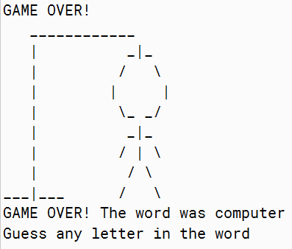
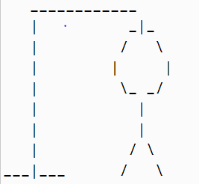
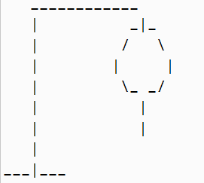
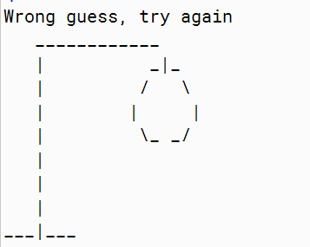
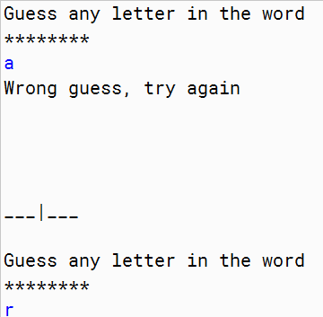
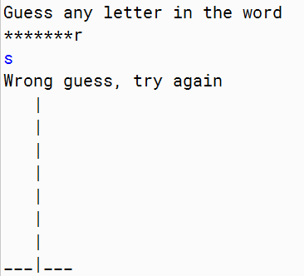
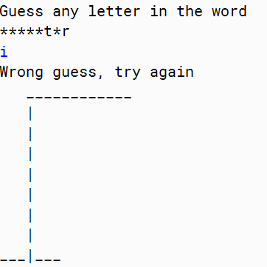
For Every Wrong Guess…
And FINALLY…

Slide 4
The game is a JAVA based program.
A mix of basic JAVA codes, it makes up this interesting game.
A word is defined by the user as a ‘String’ value in the very beginning of the game everytime.
Every letter entered will be compared with the letters of the word saved in the starting by user.
The respective consequences are saved in the program as a bunch of ‘If-else’ code.
About The Program:-

Slide 5
Representing the Hangman Game
The Game provides the player with two choices- For SINGLE USER our game will choose the word to be guessed randomly from a pre-installed array of string data type.
For MULTI USER, we would let one of the users to enter the word to be guessed and the player will be required to guess the word!

Slide 6
The Attributes of our HangmanGame class:-
The word the user must guess
The word found to show the progression of the user during the Hangman Game
The number of errors made by the user when trying to guess the word
A list of letters already entered by the user
Furthermore, we will use a constant fixing in which the maximum number of wrong guesses a user can make. It will give us the following declaration for the HangmanGame class:

Slide 7
Choosing the word to guess
Now,
For single user, we need to define a method letting the computer to choose the next word the user must find. This choice will be made randomly by picking an element in the WORDS array
For multi-user we’ll let the user enter the word.

Slide 8
Playing the game with user’s interaction:-
Now, We just need to assemble all the pieces inside a play(main) method. In this main block we’ll call the methods accordingly:
Checking if number of errors is lower than maximum allowed
Getting a letter from the user by using the Scanner class from the JDK
Checking if the word is found. If so, we display a win message to the user. If no, we display the number of tries remaining.
When the user has reached the maximum number of tries, we display a lose message!
Updating the word found with the letter entered

Slide 9

Block Diagram Representation Of The Game :-

Slide 10
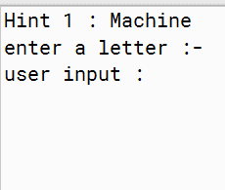
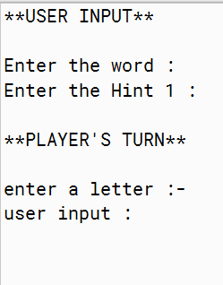
LetterAccept
Function
LetterCheck
Function
ResultGenerate
Function
Single User
Multi User
Word randomly picked from pre defined array
The Player
WordAccept
Function
LetterGenerate Function
LetterAccept function
LetterCheck Function
Word defined by another user

Slide 11
Scope of the project
Project aims at polishing our coding skills, creative and cognitive thinking, the entertainment of player, team work and unity among the teammates, gaining experience of multiple softwares, leadership.
EDITS
The edits comprise the modifications made in the original ‘Hangman Game’- the choice provided to the player, display effects, timings, etc.

Slide 12
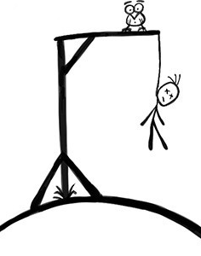
HOPE YOU ENJOY THE GAME AND SAVE YOUR MAN FROM GETTING HANGED!
THANK YOU!!
Team Credits :-
Shivani Singh : Presentation Edits, Program ideas
Sparsh Verma : Presentation building, Code Writing and Edits
Tanisha Jain : Presentation Edits, Code Writing and Editing
Tarun Pal : Code editing and Ideas

